Slide 1
Group Meeting
November 29th 2013

Slide 2
Agenda
Welcome & Introductions
Mahara 1.8 New Features (Demo)
Discussion – Improving Usability & Workflow
Tea Break
Discussion – Next Event
Any Other Business
Creating Mahara Skins (Demo)

Slide 3
New in 1.8 – the whole cheeseboard
Attachments on résumé fields
Attachments on text boxes / notes
Content chooser on the left-hand side
Display authentication method in the user search
Display external / remote username field only for required authentication methods
Display note title on Notes overview page
Don't specify gender
Drag and drop files into files area
Drop-down navigation as institution settings
Embed PDF
Filter by duplicate email addresses
Flexible page layout: Arrange content on pages in rows
Fonts
Fulltext search
Import Leap2A file
LDAP group sync
LDAP user sync
Link to profile pictures page
Override user account lifetime
Path to ClamAV shown in security settings
Safeguard before moving away accidentally before having saved information
Skins
Skins as institution settings
Tags on collections
Tags on plans
Tags on tasks
Tags on text boxes / notes
URL for publication

Slide 4
New in 1.8 – some choice bits!
Content chooser on the left-hand side
Drag and drop files into files area
Flexible page layout: Arrange content on pages in rows
Link to profile pictures page
Safeguard before moving away accidentally before having saved information
Skins – later!

Slide 5
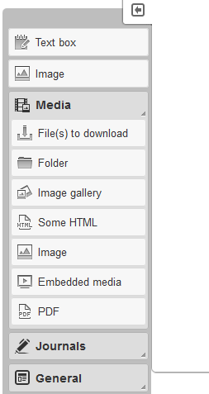
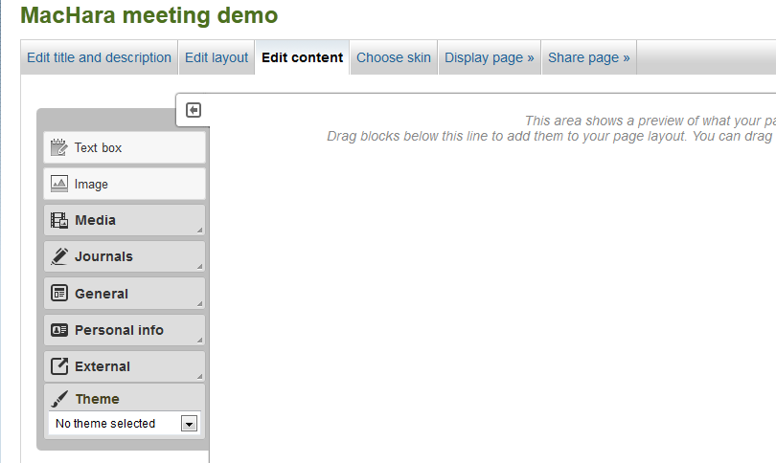
Reorganised Page Editing Layout
Notes:
Editing menu now on the side and scrolls with the page so it’s always available where you are on screen.
Add text box and image as available at top of the list for quick access as well as within their usual section

Slide 6
Drag & Drop

Slide 7
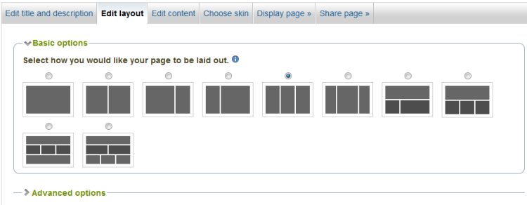
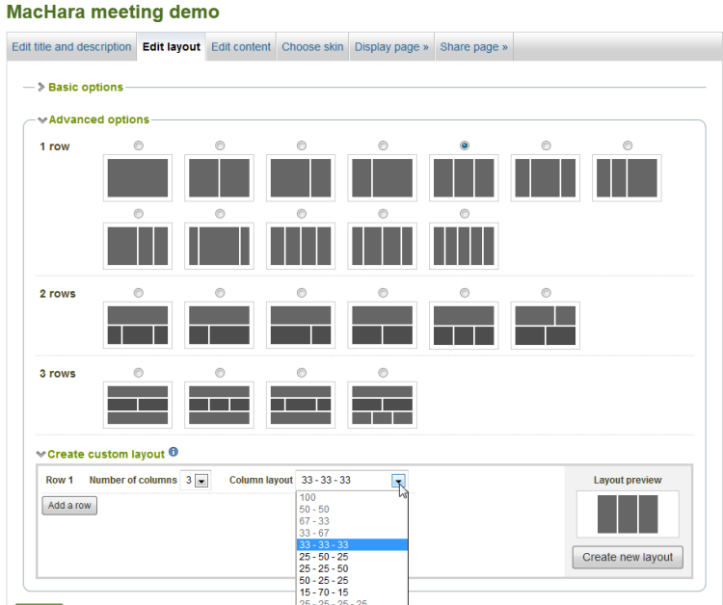
Flexible Page Layouts

Slide 8
Edit Profile Picture

Slide 9
Warning – you are about to lose work

